Slide 1
Module 2: Hardcore game programming
Module 2 contents:
Introduction to Game Design
Data Structures and Algorithms for Game Programming
The Mathematical Side of Games
Introduction to Physics Modeling

Slide 2
Introduction to Game Design
Game design is the art of applying design and aesthetics to create a game for entertainment or for educational, exercise, or experimental purposes.
Increasingly, elements and principles of game design are also applied to other interactions, in the form of gamification.
Game designer and developer Robert Zubek defines game design by breaking it down into its elements, which he says are the following:
Gameplay, which is the interaction between the player and the mechanics and systems
Mechanics and systems, which are the rules and objects in the game

Slide 3
Introduction to Game Design
Game design is part of game studies, while game theory studies strategic decision making (primarily in non-game situations). Games have historically inspired seminal research in the fields of probability, artificial intelligence, economics, and optimization theory. Applying game design to itself is a current research topic in metadesign.
Game studies or gaming theory is a discipline that deals with the critical study of games, game design, players, and their role in society and culture.

Slide 4
Introduction to Game Design
Strategic decision making:
Game theory is a study of strategic decision making.
Specifically, it is "the study of mathematical models of conflict and cooperation between intelligent rational decision-makers".
An alternative term suggested "as a more descriptive name for the discipline" is interactive decision theory.
The subject first addressed zero-sum games, such that one person's gains exactly equal net losses of the other participant or participants.

Slide 5
Introduction to Game Design
Design elements:
Games can be characterized by "what the player does" and what the player experiences. This is often referred to as gameplay. Major key elements identified in this context are tools and rules that define the overall context of game.
Tools of play:
Games are often classified by the components required to play them (e.g. miniatures, a ball, cards, a board and pieces, or a computer).

Slide 6
Introduction to Game Design
Design elements:
Tools of play:
In places where the use of leather is well established, the ball has been a popular game piece throughout recorded history, resulting in a worldwide popularity of ball games such as rugby, basketball, football, cricket, tennis, and volleyball.
Other tools are more idiosyncratic to a certain region. Many countries in Europe, for instance, have unique standard decks of playing cards. Other games such as chess may be traced primarily through the development and evolution of its game pieces.

Slide 7
Introduction to Game Design
Design elements:
Tools of play:
Many game tools are tokens, meant to represent other things. A token may be a pawn on a board, play money, or an intangible item such as a point scored.
Games such as hide-and-seek or tag do not utilise any obvious tool; rather, their interactivity is defined by the environment.
Games with the same or similar rules may have different gameplay if the environment is altered. For example, hide-and-seek in a school building differs from the same game in a park; an auto race can be radically different depending on the track or street course, even with the same cars.

Slide 8
Introduction to Game Design
Design elements:
2. Rule development:
Games are often characterized by their tools, they are often defined by their rules.
While rules are subject to variations and changes, enough change in the rules usually results in a "new" game.
There are exceptions to this in that some games deliberately involve the changing of their own rules, but even then there are often immutable meta-rules.

Slide 9
Introduction to Game Design
Design elements:
2. Rule development:
Rules generally determine turn order, the rights and responsibilities of the players, each player's goals, and how game components interact with each other to produce changes in a game's state.
Player rights may include when they may spend resources or move tokens.

Slide 10
Introduction to Game Design
Design elements:
3. Victory conditions:
Common win conditions are being first to amass a certain quota of points or tokens (as in Settlers of Catan), having the greatest number of tokens at the end of the game (as in Monopoly), some relationship of one's game tokens to those of one's opponent (as in chess's checkmate), or reaching a certain point in a storyline (as in most roleplay-games).

Slide 11
Introduction to Game Design
Design elements:
4. Single or multiplayer:
Most games require multiple players.
Single-player games are unique in respect to the type of challenges a player faces.
Unlike a game with multiple players competing with or against each other to reach the game's goal, a single-player game is against an element of the environment, against one's own skills, against time, or against chance.
This is also true of cooperative games, in which multiple players share a common goal and win or lose together.

Slide 12
Introduction to Game Design
Design elements:
4. Single or multiplayer:
Many games described as "single-player" or "cooperative" could alternatively be described as puzzles or recreations, in that they do not involve strategic behavior (as defined by game theory), in which the expected reaction of an opponent to a possible move becomes a factor in choosing which move to make.
Games against opponents simulated with artificial intelligence differ from other single-player games in that the algorithms used usually do incorporate strategic behavior.

Slide 13
Introduction to Game Design
Design elements:
5. Storyline and plot:
Many Stories told in games may focus on narrative elements that can be communicated through the use of mechanics and player choice.
Narrative plots in games generally have a clearly defined and simplistic structure.
Mechanical choices on the part of the designer(s) often drastically affect narrative elements in the game.
However, due to a lack of unified and standardized teaching and understanding of narrative elements in games, individual interpretations, methods, and terminology vary wildly.

Slide 14
Introduction to Game Design
Design elements:
5. Storyline and plot:
Because of this, most narrative elements in games are created unconsciously and intuitively.
However, as a general rule, game narratives increase in complexity and scale as player choice or game mechanics increase in complexity and scale.
One example of this is removing a players ability to directly affect the plot for a limited time.
This lack of player choice necessitates an increase in mechanical complexity and could be used as a metaphor to symbolize depression that is felt by a character in the narrative.

Slide 15
Introduction to Game Design
Design elements:
6. Luck and strategy:
A game's tools and rules will result in its requiring skill, strategy, luck, or a combination thereof, and are classified accordingly.
Games of skill include games of physical skill, such as wrestling, tug of war, hopscotch, target shooting, and horseshoes, and games of mental skill such as checkers and chess. Games of strategy include checkers, chess, go, arimaa, and tic-tac-toe, and often require special equipment to play them. Games of chance include gambling games (blackjack, mah-jongg, roulette, etc.), as well as snakes and ladders and rock, paper, scissors; most require equipment such as cards or dice.

Slide 16
Introduction to Game Design
Design elements:
6. Luck and strategy:
Most games contain two or all three of these elements. For example, American football and baseball involve both physical skill and strategy while tiddlywinks, poker, and Monopoly combine strategy and chance.
Many card and board games combine all three; most trick-taking games involve mental skill, strategy, and an element of chance, as do many strategic board games such as Risk, Settlers of Catan, and Carcassonne.

Slide 17
Introduction to Game Design
Design elements:
7. Use as educational tool:
By learning through play children can develop social and cognitive skills, mature emotionally, and gain the self-confidence required to engage in new experiences and environments.
Key ways that young children learn include playing, being with other people, being active, exploring and new experiences, talking to themselves, communicating with others, meeting physical and mental challenges, being shown how to do new things, practicing and repeating skills, and having fun.

Slide 18
Introduction to Game Design
Design elements:
7. Use as educational tool:
Play develops children's content knowledge and provides children the opportunity to develop social skills, competencies, and disposition to learn.
When children engage in real-life and imaginary activities, play can be challenging in children's thinking.
To extend the learning process, sensitive intervention can be provided with adult support when necessary during play-based learning.

Slide 19
Data Structures and Algorithms for Game Programming
DEFINITION OF DATA STRUCTURES:
A data structure defines how data is arranged in memory and can be operated on by using various algorithms.
One of the most basic data structures used in general computer programming is the array.
An array is a data structure because it defines how data is arranged in memory, in this case a heap of variables or objects of a specific type (or types in typeless languages), which can be operated on by various algorithms (e.g., insertion into the array, deletion, searching, sorting, and so forth).

Slide 20
Data Structures and Algorithms for Game Programming
DEFINITION OF DATA STRUCTURES:
Arrays
Link lists
Queues
Stacks
Heaps
Graphs
Scene graphs
Octrees

Slide 21
Data Structures and Algorithms for Game Programming
DEFINITION OF DATA STRUCTURES:
Quad-trees
Binary trees
Minimax trees
kd trees
Sphere trees
Bounding volume hierarchies
Hash tables
Portals and sectors

Slide 22
Data Structures and Algorithms for Game Programming
DEFINITION OF ALGORITHMS:
An algorithm is code that manipulates data in data structures.
Recursion
Insertions
Deletions
Merging
Various sorting algorithms
Various searching algorithms

Slide 23
Data Structures and Algorithms for Game Programming
DEFINITION OF ALGORITHMS:
An algorithm is code that manipulates data in data structures.
Transversal
Various algorithms for balancing trees
Data compression
Texture compression
Data encryption
Texture filters

Slide 24
Data Structures and Algorithms for Game Programming
DATA STRUCTURES IN GAMES AND SIMULATIONS:
Data structures and algorithms in game development are often used to speed up the processing of a game’s data.
Here we are focusing on how we can manage data objects in a gaming application.
These data describe entities that need to be processed in a manner that benefits the overall application’s performance, performs some calculations needed to create an effect (e.g., artificial intelligence, physics, etc.), or takes data in one form and transforms them into another.

Slide 25
Data Structures and Algorithms for Game Programming
DATA STRUCTURES IN GAMES AND SIMULATIONS:
The main questions that will be addressed are:
How to store data efficiently in the computer’s memory
How to process data efficiently
What algorithms work best under what situations and why
How various popular algorithms compare to one another in specific situations
What data structures can help the processing of game data in certain situations

Slide 26
Data Structures and Algorithms for Game Programming
DATA STRUCTURES IN GAMES AND SIMULATIONS:
Some data structures that we’ll look at model real-world situations and objects.
For example, a queue data structure, can be used to store a queue of networking messages for an online game.
Another example of this can be seen in a graph where the nodes of the graph represent cities across the United States.

Slide 27
Data Structures and Algorithms for Game Programming
DATA STRUCTURES FOR SCENE MANAGEMENT:
Complex virtual environments in modern video games are often more complex than the hardware can handle all at once.
In games thousands of polygons are rendered and processed, special effects are updated and drawn, and physics need to be processed that can quickly overwhelm any system’s hardware.
Since the beginning of 3D games, data structures and algorithms have been used to speed up the rendering of complex scenes that otherwise would bring an application’s performance down to noninteractive (unplayable) rates.

Slide 28
Data Structures and Algorithms for Game Programming
DATA STRUCTURES FOR SCENE MANAGEMENT:
Using data structures for managing scenes often comes down to situations such as needing a fast means of determining what geometry is visible to avoid sending geometry down the pipeline that can’t be seen by the viewer, avoiding or minimizing bottlenecks and state changes in the system, and efficiently managing the static and dynamic objects that exist in the game world.
Scene and resource management are two of the topics that are essential to all modern 3D games and their frameworks, also known as the game engine.

Slide 29
Data Structures and Algorithms for Game Programming
DATA STRUCTURES FOR SCENE MANAGEMENT:
As an example of state management, consider a situation where a game has 20 high-resolution textures that are shared among 500 surfaces.
If the rendering code sets up the texture and other effect parameters, renders the surface, and then moves onto the next object and does the same thing for all objects, the application could be wasting a lot of processing time with unnecessary rendering state changes.
Grouping surfaces together that use the same states (textures, shaders, and so forth) reduces the number of state changes, which increases performance.

Slide 30
Data Structures and Algorithms for Game Programming
DATA STRUCTURES FOR SCENE MANAGEMENT:
Not only does this mean rendering all surfaces that use texture A together before moving to all that use texture B, but it also means not wasting processing time moving the same data down the system if it is already there (e.g., sending the same shader uniform values that are already there or re-applying the current shader).

Slide 31
Data Structures and Algorithms for Game Programming
DATA STRUCTURES FOR SCENE MANAGEMENT:
State changes such as textures and shaders are very expensive, and spending time reducing them is far more beneficial than allowing them to take place in a complex gaming environment.
This kind of optimization occurs in many areas of game development, especially rendering, and can be used to push the envelope of what a system can do in real time.

Slide 32
Data Structures and Algorithms for Game Programming
DATA STRUCTURES FOR ARTIFICIAL INTELLIGENCE:
Artificial intelligence (AI) drives many gaming experiences.
It can be simple or complex.
Even in simple AI systems various data structures and algorithms are used to control the behavior of dynamic game elements.
As the AI gets more complex, speed becomes more of an issue because the more complex the algorithms, the more processing time is needed to complete its operations.

Slide 33
Data Structures and Algorithms for Game Programming
DATA STRUCTURES FOR ARTIFICIAL INTELLIGENCE:
Combine that with multiple objects, each needing to execute AI algorithms, and you can find yourself trying to balance realism with performance, much like rendering and physics.
For this reason, game AI is often not as complex and extensive as AI used in robotics and other such technologies, but game AI is a very complex and growing field.
As gamers’ demands increase, so will this and other areas of game development.

Slide 34
Data Structures and Algorithms for Game Programming
DATA STRUCTURES FOR PHYSICS DYNAMICS AND COLLISIONS:
Physics is becoming a standard feature in modern 3D games. Physics in games deals with the realistic representation of a game object as well as how it interacts with its environment.
This includes forces that act on the objects (e.g., gravity, wind, and so forth) as well as the resulting forces that result from objects interacting with each other, mainly through collisions.

Slide 35
Data Structures and Algorithms for Game Programming
DATA STRUCTURES FOR PHYSICS DYNAMICS AND COLLISIONS:
Physics and collisions have their own set of data structures and algorithms (e.g., point masses, rigid bodies, algorithms to apply external forces, resolve interactions, and so forth) that are performed to allow objects to interact in real time with each other and their environment.

Slide 36
Data Structures and Algorithms for Game Programming
DATA STRUCTURES FOR PHYSICS DYNAMICS AND COLLISIONS:
Because physics and collisions are so expensive, other data structures and algorithms that are used for scene management are also used in physics to help eliminate unnecessary calculations, such as trying to find collisions between two objects that have no way of being able to touch one another in order to improve performance.

Slide 37
Data Structures and Algorithms for Game Programming
DATA STRUCTURES FOR PHYSICS DYNAMICS AND COLLISIONS:
Because physics and collisions are so expensive, other data structures and algorithms that are used for scene management are also used in physics to help eliminate unnecessary calculations, such as trying to find collisions between two objects that have no way of being able to touch one another in order to improve performance.
Data structures can be seen in many areas of application design. Being able to efficiently define data structures and the algorithms that operate on them is the key to creating a solid and effective product.

Slide 38
Data Structures and Algorithms for Game Programming
DATA STRUCTURES FOR SCENE MANAGEMENT:
Scene management is a general term used to describe the management of a game’s data as the game is being played.
Many kinds of resources can be placed into a game world, and this data is becoming larger in size and more complex in its commercial quality.
The resources that can be found in the average game include but are not limited to:
Scripts
Static objects
Dynamic objects

Slide 39
Data Structures and Algorithms for Game Programming
DATA STRUCTURES FOR SCENE MANAGEMENT:
Animations
Environments
Particles
Sounds
Textures
Graphical user interface elements
Fonts
Cinematic videos

Slide 40
Data Structures and Algorithms for Game Programming
DATA STRUCTURES FOR SCENE MANAGEMENT:
Each of the resources in a video game needs to be managed by the application.
On top of that the hardware can also play a part in how the data is managed.
For example, on video game consoles resources often need to be read off a CD-ROM or DVD-ROM disk, which takes time.
Video game consoles also have limited amounts of memory, which can have a huge impact on the amount of data that can be read and stored.

Slide 41
Data Structures and Algorithms for Game Programming
DATA STRUCTURES FOR SCENE MANAGEMENT:
This falls under the scope of resources management, and various techniques can be used to allow for gameplay experiences that are more complex than what the hardware can handle.
An example of this can be seen in the Grand Theft Auto series, where the massive open-world environments are dynamically managed and loaded as the player explores the game world.

Slide 42
Data Structures and Algorithms for Game Programming
DATA STRUCTURES FOR SCENE MANAGEMENT:
Without complex resource management data structures and algorithms, the game world would be much too large and complex for consoles such as Sony’s PlayStation 2 to render using a brute force
approach.

Slide 43
Data Structures and Algorithms for Game Programming
DATA STRUCTURES FOR SCENE MANAGEMENT:
One major difference between resource management and scene management is that resource management aims are managing the data of the resources in terms of loading, unloading, and so on, while scene management generally organizes the data of a scene so that it can be efficiently processed once loaded.

Slide 44
Data Structures and Algorithms for Game Programming
DATA STRUCTURES FOR SCENE MANAGEMENT:
State management:
In games there are often a lot of rendering state changes in a scene.
These state changes can include changing textures, shaders, material information, and so forth.
If a new object needs to be rendered, its states must be applied so that the rendering system can display the geometry as intended.

Slide 45
Data Structures and Algorithms for Game Programming
DATA STRUCTURES FOR SCENE MANAGEMENT:
State management:
The problem with changing states is that some of them can be expensive.
Changing textures and changing shaders are among the most expensive state changes that occur.
The cost of changing states can add up and have an impact on a game’s performance.
The more objects that are in the scene, the worse is the potential for the state changes to have a negative impact on performance.

Slide 46
Data Structures and Algorithms for Game Programming
DATA STRUCTURES FOR SCENE MANAGEMENT:
State management:
The idea behind state management is to try to minimize the state changes as much as possible to improve performance.
One way to do this can be seen with textures.
If five objects use texture A, and five objects use texture B, it makes sense to render all the objects that use texture A first and then render all the objects that use texture B. It also makes sense to not reapply the texture data for every object, by only sending the data once and using it for all objects that share it.

Slide 47
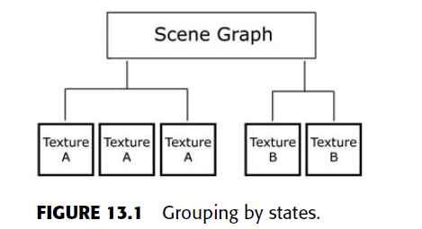
Data Structures and Algorithms for Game Programming
DATA STRUCTURES FOR SCENE MANAGEMENT:
State management:
An example of this is shown in following Figure , where the number of state changes goes from 10 to 2 when objects are grouped based on their material.

Slide 48
Data Structures and Algorithms for Game Programming
DATA STRUCTURES FOR SCENE MANAGEMENT:
State management:
In modern games state management is a topic that should be taken seriously because poor state management can have an impact on performance.
This falls under the topic of general scene management because the objects in the scene that need to be rendered are managed in a way that allows them to be displayed in a manner that can be beneficial to performance.
If you are developing your own game, then keep state management in mind.

Slide 49
Data Structures and Algorithms for Game Programming
DATA STRUCTURES FOR SCENE MANAGEMENT:
State management:
State management deals not only with shaders and textures but with any state that can be changed.
This includes alpha blending, culling, and so forth. Normally the most expensive state changes that add up quickly are shaders and textures in OpenGL and Direct3D.

Slide 50
Data Structures and Algorithms for Game Programming
DATA STRUCTURES FOR SCENE MANAGEMENT:
TEXTURE ATLASES:
Another way to reduce state changes, as far as textures are concerned, is to group textures together into larger ones so that objects that don’t share the same decal can still use the same larger texture data.
A texture atlas is a large texture made up of multiple smaller textures. By grouping those textures, the need to apply different textures before the rendering of an object or objects can be reduced.

Slide 51
Data Structures and Algorithms for Game Programming
DATA STRUCTURES FOR SCENE MANAGEMENT:
TEXTURE ATLASES:
The downside is that the larger textures can be very large, which increases the size of the data that is being sent to the hardware when a texture is applied for rendering.
Also, since graphics hardware supports a maximum resolution for textures, the smaller textures in the atlas have a limited resolution because more than one of them must fit in the larger texture.
An example of a texture atlas is shown in Figure 13.2, where four textures are placed in one atlas.

Slide 52
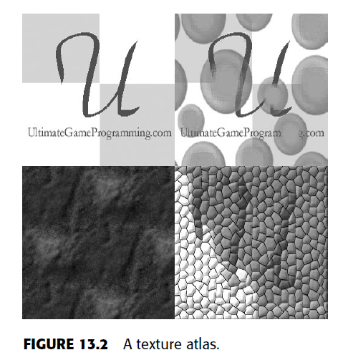
Data Structures and Algorithms for Game Programming
DATA STRUCTURES FOR SCENE MANAGEMENT:
TEXTURE ATLASES:

Slide 53
Data Structures and Algorithms for Game Programming
DATA STRUCTURES FOR SCENE MANAGEMENT:
TEXTURE ATLASES:
The objects using any of those subtextures access the same larger texture, which means they can be grouped together in a state management system.
There is slight added complexity when working with texture coordinates of a geometric model and textures in an atlas that must also be taken into account since adjustments to those coordinates must be made.

Slide 54
The Mathematical side of games
Game Math:
Mathematics is used throughout many aspects of a video game, and having an understanding of the different kinds of math is important to being able to create the kinds of applications that gamers expect.
In this section we will briefly discuss a few math objects these math objects include
vectors
bounding volumes
planes
Frustums
cameras.

Slide 55
The Mathematical side of games
Vectors:
Vectors are used heavily in three-dimensional games and are the foundation for many calculations that take place.
A vector is a direction, and when talking about
two-dimensional vectors, those are directions specified in terms of an x- and y-axis, while three-dimensional vectors have an x-, y-, and z-axis.

Slide 56
The Mathematical side of games
Vectors:
A vertex is a point in a virtual space.
Most often the term vector is used to describe either a vertex point or a direction vector.
A vector with a magnitude of 1 is known as a unit-length normal, often just called a normal.

Slide 57
The Mathematical side of games
Vectors:
A class was created to represent a three-dimensional vector and includes overloaded operators for basic arithmetic (e.g., +, –, *, /, etc.) as well as operations such as normalizing a vector (creating a normal), finding the magnitude of a vector, and calculating the cross product of a vector as well as the dot product.
These are few common operations that are found when working with vectors.

Slide 58
The Mathematical side of games
PLANES:
A plane is an infinitely flat surface that extends in two axes.
Planes are used for many things such as collision detection.
In this topic the binary space partitioning data structure and various algorithms use planes to perform their duties.
A plane object is made up of a normal, which is normally expressed as A, B, and C, and it is made up of a distance. This distance specifies how far the plane is from the point of origin, which has an x, y, and z location of (0, 0, 0).

Slide 59
The Mathematical side of games
PLANES:
The plane class in this chapter will have a function used to calculate a plane from a triangle; test if a box, sphere, or point intersects a plane; and test which side of a plane a point is on.
A vertex point can be either on the front side of the plane, on back side, or on the plane.
Geometric primitives such as triangles, can also span
both sides of a plane, with a piece being on the front side and the rest crossing over to the back side.
The side of the plane is determined by the plane’s normal.

Slide 60
The Mathematical side of games
BOUNDING VOLUMES:
Bounding volumes are shapes used to surround a geometric object. There are many different types of bounding volumes, but the most popular are the axis-aligned bounding box and bounding sphere. Bounding volumes are used to enclose (tightly surround) a geometric object so that they can be used as very simplified and general representations of those objects.
For example, if a bounding box is surrounding a
three-dimensional character model, early tests can be done on the bounding box instead of the more complex three-dimensional character model.

Slide 61
The Mathematical side of games
BOUNDING VOLUMES:
An example of one test is visibility determination, which can be used to quickly determine if the geometric model is visible to the viewer.
Since the bounding volume tightly surrounds the object, it can act as a simple stand-in for many tests that would otherwise be expensive to do on a polygonal object with hundreds if not thousands of polygons.

Slide 62
The Mathematical side of games
BOUNDING VOLUMES:
To create a bounding box, or any bounding volume,
we have to loop through the geometric object and determine its extents so that the simplified bounding shape can be calculated around the object.
For a box the minimum and maximum x, y, and z axes must be determined, which can be used to specify the corners of the bounding box. For a bounding sphere the same operation can be used, but the center of the object must be calculated, which is the maximum and minimum axes added together and divided by two, as well as the sphere’s radius, which is the square root of the maximum axis’s distance from the sphere’s center.

Slide 63
The Mathematical side of games
FRUSTUM CULLING:
Frustum culling is the process of determining what objects are visible within a view frustum so that those objects are the only ones sent to the rendering system.
To create a view frustum six planes are needed. These planes represent the left, right, top, bottom, far, and near planes that, when working together, completely enclose a volume around the virtual camera.

Slide 64
The Mathematical side of games
FRUSTUM CULLING:
A frustum is calculated by creating six planes based on the camera’s information.
This information includes the near and far distances, which are basically how far and how close the camera can see, the aspect ratio, the field of view, and the camera’s state, such as its position, looking direction, and so forth.
Once a frustum has been created, geometric objects can be tested against it for visibility determination. If an object is on the front side of all planes that make up the frustum, it is visible. If an object is behind at least one of these planes, the object is not visible.

Slide 65
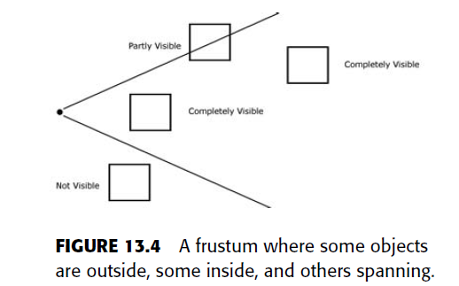
The Mathematical side of games
FRUSTUM CULLING:

Slide 66
The Mathematical side of games
FRUSTUM CULLING:
When testing against a frustum, it is common to test the bounding volume of an object instead of the object itself.
This can lead to a very fast visibility test, which is important in trying to keep the frame rate of an application acceptable.
By testing the object itself, all polygons of the model would have to be tested, which would cause a major slowdown in the performance with a few high polygonal models compared to using the bounding volume.

Slide 67
The Mathematical side of games
FRUSTUM CULLING:
Testing simple bounding volumes drastically reduces this workload. The frustum class is shown in Listing 13.4 and can be used to test if a point, box, or sphere is visible.

Slide 68
The Mathematical side of games
VIEWS AND CAMERAS:
The upcoming demo applications can benefit from allowing the user to roam around the virtual environment.
Since a full-blown, complex camera system is not needed, a simple one is made available in this chapter.
This simple camera class will keep track of the camera’s position and a view direction.

Slide 69
The Mathematical side of games
VIEWS AND CAMERAS:
The camera is always moved along its viewing direction.
If the direction is rotated, which it is in the function RotateView(), then the direction the camera is moving can be altered.
The members of the camera class can be fed directly to OpenGL.

Slide 70
The Mathematical side of games
Additional game math:
Other types of math objects include:
Rays
Matrices
Quaternion rotations
Additional bounding volumes
Occlusion fields

Slide 71
The Mathematical side of games
SCENE GRAPHS:
A scene graph is a data structure that is used to specify the relationships between objects in a virtual environment.
The relationships between objects form a hierarchy in which nodes are connected to one another by edges and can be objects’ spatial relationships, materials, physical relationships (e.g., a character picking up a weapon or a character riding in a vehicle), and so forth.
An example of a scene graph is shown in Fig.

Slide 72
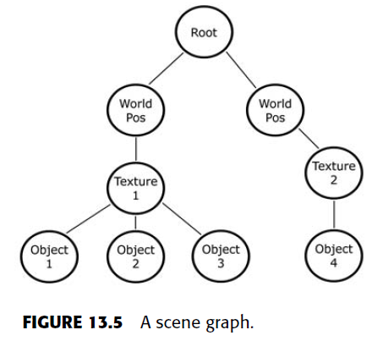
The Mathematical side of games
SCENE GRAPHS:

Slide 73
The Mathematical side of games
SCENE GRAPHS:
A scene graph is a very general data structure. In video games this data structure is often highly application specific and is generally not made up of a concrete set of rules or definitions.
Because scene graphs are so general, there is no right or wrong way to create them.
In Figure 13.5 the illustration defines a scene graph that specifies spatial and material relationships.

Slide 74
The Mathematical side of games
SCENE GRAPHS:
During the creation of a scene graph, the implementation depends highly on the game specifics.
If a game has static objects in specific areas like in Figure 13.5, then grouping objects by location might be a feature of that game’s scene graph.
If objects can be grouped by material, all objects that share the same texture, shader, and so forth can be conveniently grouped in a subtree.

Slide 75
The Mathematical side of games
SCENE GRAPHS:
Another situation in which scene graphs can be used is to define physical relationships, such as when a character model hops in a vehicle and drives it around the environment, which causes a relationship between the two objects to allow one model’s movements and orientations to affect the other.
Implementing a scene graph requires taking the basic ideas and principles of a scene graph and building on them for the needs of a specific game.

Slide 76
The Mathematical side of games
NODES OF A SCENE GRAPH:
In a scene graph the data structure can be implemented using a graph or a tree.
In some cases scene graphs can be implemented using basic data structures such as an array or a link list as well.
In a scene graph built from a tree or graph a node can have multiple children but only one parent.
Depending on the game specifics, the parent node affects the children and so forth down the hierarchy.

Slide 77
The Mathematical side of games
NODES OF A SCENE GRAPH:
In Figure 13.5 a transformation node was used to position all objects in a subgroup to one general location.
Each of these objects had their own transformations that were added and applied further to that main transformation.

Slide 78
The Mathematical side of games
NODES OF A SCENE GRAPH:
The scene graph will be simple and will implement transformation nodes and sphere nodes.
The transformation nodes will be used to apply transformation information to the OpenGL API, while the sphere nodes will be used to draw a sphere shape.
The nodes will use inheritance, and both types (transformation and sphere) will derive from one node.

Slide 79
The Mathematical side of games
NODES OF A SCENE GRAPH:
A game’s scene graph can have additional types of nodes that are specific to the game.
Nodes can be used to group objects by material, physical relationship, which was discussed in the example of a character model getting into a vehicle, and whatever else the game needs to group by.

Slide 80
The Mathematical side of games
IMPLEMENTING A SCENE GRAPH:
The scene graph will be implemented using a general tree data structure.
The scene graph will have a class for the nodes
which will act as a base class from which the other two classes, one for transformations and one for the spheres, will be derived.
In the base class for the nodes, the nodes will store their child pointers and their sibling pointers. The sibling pointers form a doubly linked list and are used to chain the nodes together.

Slide 81
The Mathematical side of games
IMPLEMENTING A SCENE GRAPH:
The entire scene graph is processed by calling the Process() function on the root node, which will recursively handle all nodes in the graph. This is used in this demo to display and apply the information in each node so that we can see it on the screen.

Slide 82
The Mathematical side of games
BINARY SPACE PARTITIONING TREES:
The binary space partitioning (BSP) data structure has been used for a long time in the game industry for processing three-dimensional virtual scenes.
With a BSP tree a tool is used to take the polygons of a level and create a hierarchy out of them. This hierarchy can quickly be processed by the application at run time to increase overall performance.

Slide 83
The Mathematical side of games
BINARY SPACE PARTITIONING TREES:
In a BSP tree it is possible to traverse through the data structure’s contents in front-to-back or back-to-front order.
The BSP tree can be used for rendering, collision detection, or large-scale culling of the scene’s geometry through the use of other structures such as potential visibility sets.

Slide 84
The Mathematical side of games
BINARY SPACE PARTITIONING TREES:
In a BSP tree the child nodes are often called the front and back nodes instead of left and right.
The BSP recursively partitions a scene into two sections.
First, a plane is chosen as the splitter plane.
This plane is tested against all polygons, and the ones on the front are placed in the front node for further processing, the ones on the back of the plane are placed in the back node, and all polygons that span both sides of the plane are broken into two pieces so that one can be placed on the front and the other on the back.

Slide 85
The Mathematical side of games
BINARY SPACE PARTITIONING TREES:
Figure 13.7 shows a simple environment split into halves using a plane.
The idea behind the BSP tree is that a plane is chosen, the scene is partitioned into halves, and this recursively happens until some condition is met.
This condition can be that a certain number of polygons (minimum) has been reached in one node or a certain depth level has been reached.

Slide 86
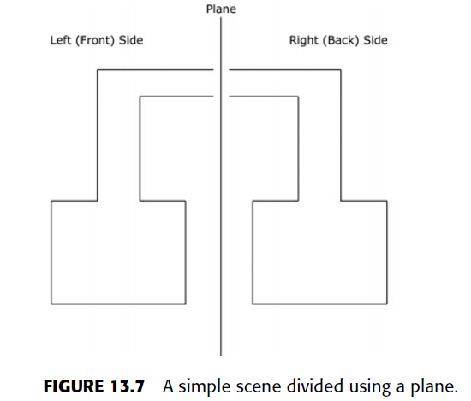
The Mathematical side of games
BINARY SPACE PARTITIONING TREES:

Slide 87
The Mathematical side of games
BINARY SPACE PARTITIONING TREES:
Many games use the BSP tree. Among the most popular are the early Doom and Quak games from Id Software. Modern games that use BSP trees include Half-Life 2, Quake 4, Doom 3, and many others. Although games today use BSP trees that are slightly different than in the past, they are still a part of game development.
When it comes to rendering, BSP trees are often used with other structures such as potential visibility sets. In the early days this was first done with the first Quake, where the performance of the traditional BSP tree suffered in some areas of game levels.

Slide 88
The Mathematical side of games
BINARY SPACE PARTITIONING TREES:
Before there were Z-buffers in the graphics hardware there was a need to be able to correctly render polygons in the right order (from back to front).
If polygons were not rendered is a specific order, polygons that are supposed to appear behind others might be rendered on top.
The BSP tree was a way to partition the scene so this order can be quickly determined and the polygons of a level rendered correctly.

Slide 89
The Mathematical side of games
BINARY SPACE PARTITIONING TREES:
In today’s games we have fast Z-buffers in the graphics hardware, so using BSP trees to render the faces in the correct order is not necessary.
However, when combined with frustum culling and potential visibility sets, new BSP trees can be created and rendered that benefit speed.
BSP trees can also be used for very fast collision detection, which is important in three-dimensional games.

Slide 90
The Mathematical side of games
BINARY SPACE PARTITIONING TREES:
The planes used to split the nodes of a BSP tree are often axis-aligned, arbitrary, or coplanar with the polygons.
Axis-aligned means that the planes align to an axis(x, y, or z), arbitrary planes are used to divide the scene into near two equal or equal parts, and planes that are coplanar with the polygons are planes that are created out of chosen polygons from the scene.
An example of each type is shown in Figure 13.8.

Slide 91
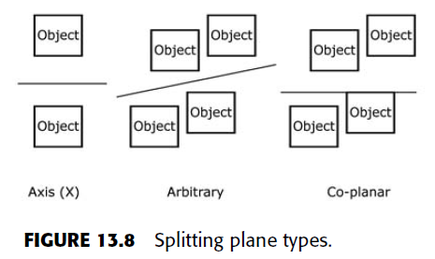
The Mathematical side of games
BINARY SPACE PARTITIONING TREES:

Slide 92
The Mathematical side of games
BSP TREE NODES:
The nodes of a BSP tree can have a list of polygons and two child nodes.
Leaf nodes have no children and have a list of polygons.
The BSP tree is a binary search tree for polygons.

Slide 93
The Mathematical side of games
BSP TREE NODES:
The creation of a BSP tree is a generally simple process (in theory) and is made up of the following steps:
1. Take a list of polygons and send it to the node (root node if this is the first node).
2. Calculate a plane that will be used as the splitter plane.
3. Loop through all polygons and determine which side the polygons lie on.If any span the plane, split them into two new planes.
4. Repeat steps 1 through 3 for the left (front) and right (back) nodes recursively until a certain number of polygons are in a node, until a certain depth is reached, or until some other condition (whatever condition you see fit to stop the recursion) is met.

Slide 94
The Mathematical side of games
BSP TREE NODES:
The first thing to note is that BSP trees by themselves are better for indoor scenes than outdoor scenes.
This is because the splitting planes on the terrain of an outdoor scene will not be as efficient as an indoor one.
One of the challenges of making a BSP tree is to pick a good splitter plane.
If the tree is severely unbalanced, performance traversing the tree can suffer.

Slide 95
The Mathematical side of games
BSP TREE NODES:
On the accompanying CD-ROM is a demo application called BSP Tree that creates a BSP tree out of a simple list of polygons. This BSP tree is rendered to the screen in back-to-front order. The splitting plane is chosen using a scoring algorithm that performs these steps:
1. Loop through all polygons and create a plane for each one.
2. For each plane add up the number of polygons that are on the front side and on the back side.
3. Whichever plane has the lowest absolute difference (abs[front total – back total]) is the best polygon to use for the splitting plane (also known as the score).

Slide 96
The Mathematical side of games
BSP TREE NODES:
Such a simple algorithm should create a fairly balanced tree since it chooses planes that have equal or close to equal numbers of polygons on each side.
To implement such an algorithm a loop can be used to create and score each polygon while keeping track of the current best.
Once the algorithm is done, the one marked as the current best is the one to use.

Slide 97
The Mathematical side of games
BSP TREE NODES:
Building a BSP tree is often a preprocessing step because of the time it will take to create the data structure.
Adding potential visibility sets can drastically increase
this build time.
This is not a problem, since a level is loaded during runtime, but it does require the geometry of the environment itself be static.
The objects do not need to be static and would not be part of the BSP tree anyway.

Slide 98
The Mathematical side of games
QUAD-TREES AND OCTREES:
Bounding volume hierarchies are used for fast culling of a scene’s geometry.
In a bounding volume hierarchy a bounding volume is created to enclose the entire scene.
The main bounding volume is then recursively divided into smaller sections.
When a bounding volume is divided, all polygons that fall within that volume are added to that node.

Slide 99
The Mathematical side of games
QUAD-TREES AND OCTREES:
This recursion continues until a certain depth level is reached or until a minimum number of polygons have been reached.
In this section we will talk about two popular bounding volume hierarchies known as the quad-tree and the octree.

Slide 100
The Mathematical side of games
QUAD-TREES :
A quad-tree starts with one large axis-aligned bounding box around the environment.
It then recursively splits this box into four equal subboxes.
These four subboxes are the four child nodes, just like the front and back were child nodes of a BSP tree node.
All polygons are then placed into the node within which it falls. This process continues for the child nodes downward until some condition is met to stop the recursion, which is often until a minimum number of polygons are reached. A quad-tree is shown in Figure 13.10.

Slide 101
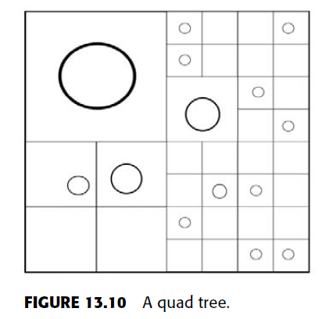
The Mathematical side of games
QUAD-TREES :

Slide 102
The Mathematical side of games
QUAD-TREES :
Building a bounding volume hierarchy like the quad-tree is easier than building a BSP tree.
In a quad-tree there are four nodes that each represent an equal area of the parent.
The polygons are separated based on if they fall within one of these boxes, and the process continues until the recursion-ending condition is met.
Using frustum culling on such a data structure would require starting at the root node and testing if it is visible.

Slide 103
The Mathematical side of games
QUAD-TREES :
If so, each of the child nodes are tested to see if they are visible.
The children of every child node that is visible are tested until the entire tree has been processed.
If some nodes are not visible, they and their children are rejected.
Thus, if a view is facing away from a section of the level, those nodes would have been quickly rejected because some of the nodes higher up in the hierarchy closest to the root would have been rejected, and thus those children that eventually did hold geometry would have also been rejected automatically.

Slide 104
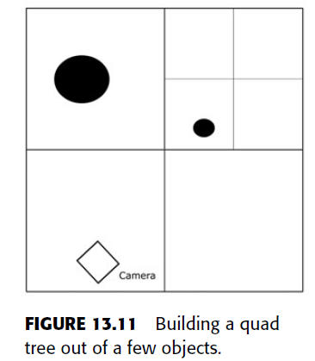
The Mathematical side of games
QUAD-TREES :
The process of building a quad-tree is shown in Figure 13.11, and using a quad-tree with frustum culling is shown in Figure 13.12.

Slide 105
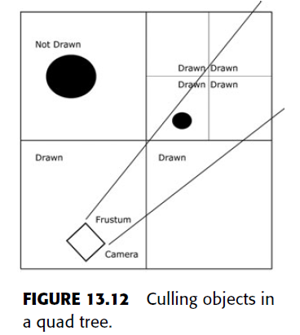
The Mathematical side of games
QUAD-TREES :
The process of building a quad-tree is shown in Figure 13.11, and using a quad-tree with frustum culling is shown in Figure 13.12.

Slide 106
The Mathematical side of games
QUAD-TREES :
Quad-trees can also be used to create terrains with nodes that have varying levels of detail.
As nodes are determined to be farther and farther away from the viewer (camera), low-detail versions of that node’s geometry can be used to decrease the rendering load on the graphics hardware.
As geometry moves further away from the camera, the detail that it holds is not as visible.
Using lower levels of detail as geometry is farther away can lead to renders that show no real noticeable difference.

Slide 107
The Mathematical side of games
OCTREES :
Octrees are essentially the same as quad-trees, but a node is split into eight boxes instead of four.
Octrees can be useful for environments where a large number of polygons can appear above a camera’s frustum and can be culled out of the rendering process.
In a quad-tree the polygons of a node are rendered if the node is visible or partially visible. It would be more expensive to cull individual polygons than groups of them, and because of this, if there are large numbers of polygons that can appear above a camera, they will be rendered even if not visible in a quadtree.

Slide 108
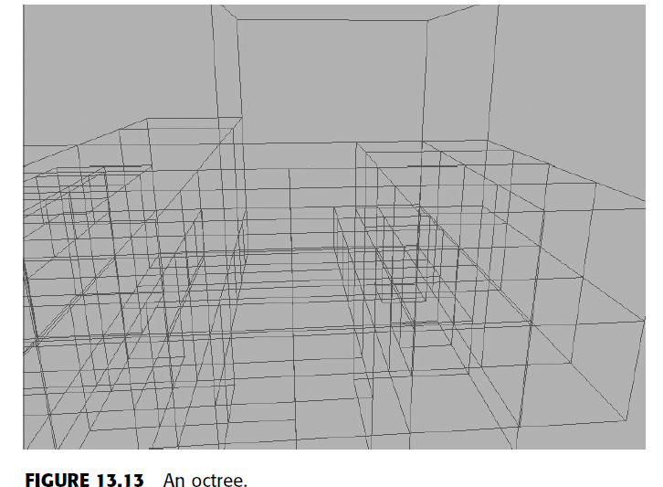
The Mathematical side of games
OCTREES :
By using an octree, these polygons can be possibly culled out. This situation is shown in Figure 13.13.

Slide 109
The Mathematical side of games
IMPLEMENTING AN OCTREE:
The Octree demo will take a simple wire-frame terrain and build an octree out of it.
It will also use frustum culling on the octree’s nodes to render only what geometry is visible.
The octree is implemented using the information for the quad-tree, with the exception of eight child nodes instead of four.
A screenshot of the demo application is shown in Figure 13.14.

Slide 110
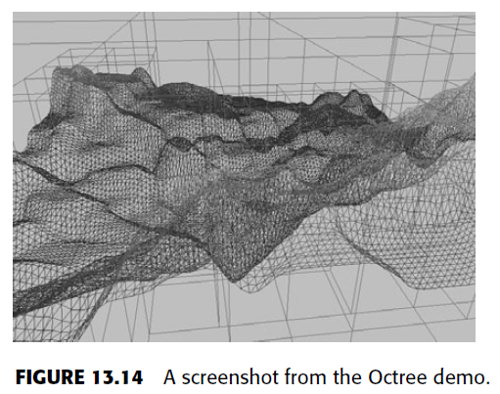
The Mathematical side of games
IMPLEMENTING AN OCTREE:

Slide 111
The Mathematical side of games
ADDITIONAL MANAGEMENT TOPICS:
The management of a scene can be very complex, with all the pieces of data that are brought together to make a virtual experience.
In this chapter the main focus has been on introducing space partitioning, but other topics are also important for game developers.
These topics include the following:
Texture compression
Level of detail
Occlusion culling
Potential visibility sets
Portal rendering

Slide 112
The Mathematical side of games
ADDITIONAL MANAGEMENT TOPICS:
In this section we will briefly discuss a few of these topics that can be used to increase the rendering performance of a scene.
TEXTURE COMPRESSION:
Textures are becoming larger in resolution and larger in numbers.
With more textures and with more textures that are made up of high resolutions, more memory is needed to store them.
There are many kinds of textures outside of color maps (also known as decal textures).

Slide 113
The Mathematical side of games
ADDITIONAL MANAGEMENT TOPICS:
TEXTURE COMPRESSION: The other kinds of textures that can be applied to a surface include:
Specular maps (gloss maps)
Alpha maps
Height and displacement maps
Bump and normal maps
Detail maps
Ambient occlusion maps
Light maps
Environment maps (i.e., cube maps, sphere maps, etc.)
High-dynamic-range light probes

Slide 114
The Mathematical side of games
ADDITIONAL MANAGEMENT TOPICS:
TEXTURE COMPRESSION:
Compression is a technique used to reduce the size of data in memory.
Compressing textures used by a game reduces the total amount of memory used.
This can allow for more textures and/or higher-resolution images.

Slide 115
The Mathematical side of games
ADDITIONAL MANAGEMENT TOPICS:
LEVEL OF DETAIL:
Many geometric objects and sections of the game world are often visible at one time in a complex game.
We discussed a few ways to quickly determine what polygons are visible so the rendering system can draw only that information.
This allows applications to spend less time on what is not visible and more time on what is.

Slide 116
The Mathematical side of games
ADDITIONAL MANAGEMENT TOPICS:
LEVEL OF DETAIL:
What about the objects that are visible to the viewer? If you take a high polygonal object and render it close to the viewer, the full detail of the character will be visible.
As the object moves farther away from the viewer, the detail becomes less visible because the object is not as close but that amount of data is still being rendered.
Level of detail is used to create different versions of a virtual object, where each level is made up of less detail than the previous one.
A screenshot of this is shown in Figure 13.15.

Slide 117
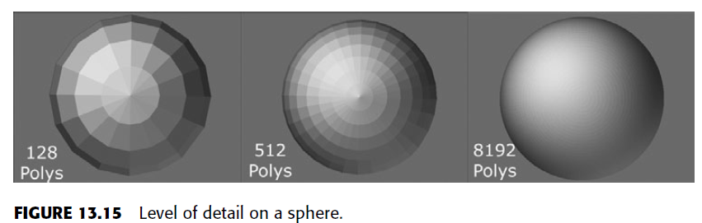
The Mathematical side of games
ADDITIONAL MANAGEMENT TOPICS:
LEVEL OF DETAIL:

Slide 118
The Mathematical side of games
ADDITIONAL MANAGEMENT TOPICS:
LEVEL OF DETAIL:
The idea is that when an object is farther from the viewer, less information can be used to render that object without a noticeable difference.
Since the object is farther away, it would be hard for a user to realize that the objects are different meshes.
Drawing lower and lower polygonal versions of an object as it gets farther away from the viewer gives the graphics hardware less work, which increases performance.

Slide 119
The Mathematical side of games
ADDITIONAL MANAGEMENT TOPICS:
LEVEL OF DETAIL:
If this is done on all objects and sections of the environment (e.g., using level of detail on octree nodes), a complex scene can be rendered quickly that would have otherwise have had the potential for low performance.

Slide 120
The Mathematical side of games
ADDITIONAL MANAGEMENT TOPICS:
OCCLUSION CULLING:
In frustum culling, everything outside of the frustum is culled, or, in other words, not rendered.
For geometry that falls within the frustum, another technique, called occlusion culling, is used to cull geometry further.
Within a frustum some visible objects can block others.

Slide 121
The Mathematical side of games
ADDITIONAL MANAGEMENT TOPICS:
OCCLUSION CULLING:
For example, a wall might block the view of objects behind it.
If objects are not visible because other objects block them, they should not be rendered if this can be quickly determined. That is what occlusion culling is.
It is a technique used to eliminate nonvisible geometry that passes the frustum culling test.
Occlusion culling increases rendering performance simply by not rendering geometry that is outside the view frustum or hidden by objects closer to the camera.

Slide 122
The Mathematical side of games
ADDITIONAL MANAGEMENT TOPICS:
OCCLUSION CULLING:
Occlusion culling has advantages and disadvantages.
On the one hand, a test can be used to determine if objects completely block the view of other objects.
On the other hand, if too many tests are being performed, in some cases the test can result in the same or worse performance than not doing anything and simply rendering the object.
As with many things in video games, a balance must be found to achieve the best results.
An illustration of occlusion culling is shown in Figure 13.16.

Slide 123
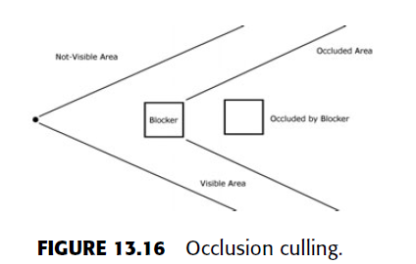
The Mathematical side of games
ADDITIONAL MANAGEMENT TOPICS:
OCCLUSION CULLING:
An illustration of occlusion culling is shown in Figure 13.16.

Slide 124
The Mathematical side of games
ADDITIONAL MANAGEMENT TOPICS:
POTENTIAL VISIBILITY SETS:
We looked at various data structures there are used to partition a virtual world into manageable blocks of bounding volumes.
Quad-trees and octrees are used to quickly determine what parts of a scene are visible and to draw only those.
In a BSP tree things are a little different, and rendering and the tree’s algorithms normally allow for front-to-back rendering. In the early days of three-dimensional games this was fine, but, as seen with Quake 1, it was determined that the BSP tree can result in bad performance depending on the design of a level.

Slide 125
The Mathematical side of games
ADDITIONAL MANAGEMENT TOPICS:
POTENTIAL VISIBILITY SETS:
Using potential visibility sets was the answer John Carmack of id Software used to solve the rendering performance issues in Quake, and they have been used ever since in many games such as Doom 3, Quake 4, and Half-Life 2.
Potential visibility sets are straightforward.
Using the BSP tree as an example, although any tree would work, every node stores a list of other nodes that it can possibly see.

Slide 126
The Mathematical side of games
ADDITIONAL MANAGEMENT TOPICS:
POTENTIAL VISIBILITY SETS:
If potential visibility sets were used, the algorithm would change to determine what node the player was in, render that node, and then render all nodes in the potential visibility set for the node the player is in.
Since octrees and quad-trees are designed to quickly reject large portions of a scene, they might not benefit too much from potential visibility sets in some situations.

Slide 127
The Mathematical side of games
ADDITIONAL MANAGEMENT TOPICS:
POTENTIAL VISIBILITY SETS:
Originally BSP trees were designed to be able to render the polygons of an environment in the proper order.
Since BSP trees are used mostly for indoor areas, there is also a lot of occluded geometry.
By creating a potential visibility sets list during the build of a level in a level editor, the in-game engine can quickly use that precomputed data to know what nodes to draw and what nodes to reject.

Slide 128
The Mathematical side of games
ADDITIONAL MANAGEMENT TOPICS:
POTENTIAL VISIBILITY SETS:
The process of building a potential visibility set out of the quad-tree is shown in Figure 13.17, where each node knows which other nodes it can potentially see.
Use of potential visibility sets is shown in Figure 13.18, where the current node the viewer is in is rendered, followed by all of the potentially visible nodes.

Slide 129
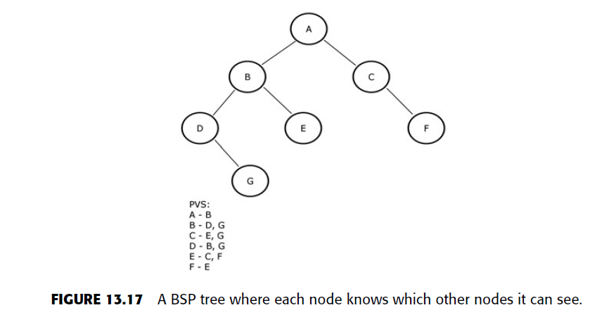
The Mathematical side of games
ADDITIONAL MANAGEMENT TOPICS:
POTENTIAL VISIBILITY SETS:

Slide 130
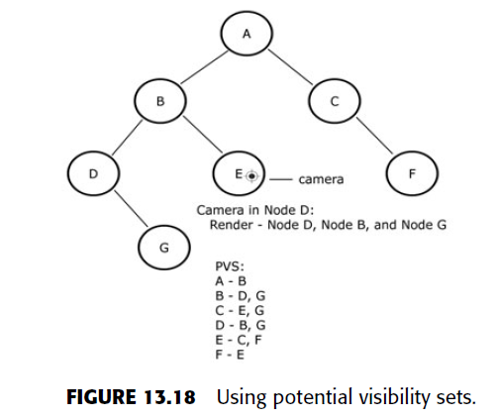
The Mathematical side of games
ADDITIONAL MANAGEMENT TOPICS:
POTENTIAL VISIBILITY SETS:

Slide 131
The Mathematical side of games
ADDITIONAL MANAGEMENT TOPICS:
PORTAL RENDERING:
Another rendering technique used from the early days of games to the present is the portal rendering technique.
In portal rendering the game world is separated into sectors.
Using a house as an example, a sector can be a room such as a bedroom or kitchen. Each sector is connected by a portal that is often a plane used to specify which portals are connected. For example, a bedroom door can be a portal that is used to connect the bedroom sector with the hallway sector. An example is shown in Figure 13.19.

Slide 132
The Mathematical side of games
ADDITIONAL MANAGEMENT TOPICS:
PORTAL RENDERING:
A number of tricks can be used for portal rendering.
The system can be set up so that the geometries of two connecting sectors are not physically next to one another.

Slide 133
The Mathematical side of games
ADDITIONAL MANAGEMENT TOPICS:
PORTAL RENDERING:
This creates a wormhole-like situation where you can cross into a portal and end up in a part of the game world that is nowhere near the area you just left. In the Xbox 360 game Prey this was used to create some very unique gameplay elements where portals existed throughout the game world and the players could not only move through them but could also look through them, sometimes even being able to look at themselves, almost as if they were looking into another universe.

Slide 134
The Mathematical side of games
PORTAL RENDERING:
The possibilities are remarkable with portal rendering.
If a player can start in a completely closed room where there is a box in the middle of the area, a portal can be attached to one of the faces on the box so that the player can walk through and end up in a completely new area. Maybe a player can hit a switch to open the portal,or the portal can already be there waiting. Either way, the trick can be used for some very weird things, such as a portal that acts like a window on one side but looks into a completely different area or a solid surface from the other side or, as in Value’s upcoming game Portal, in which sectors can have a portal that connects the sector to itself, creating a loop.

Slide 135
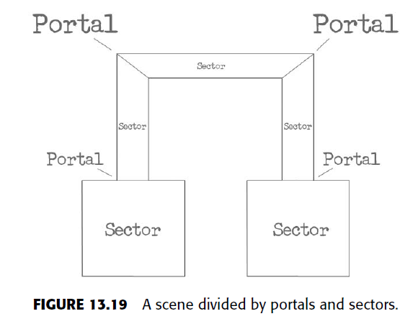
The Mathematical side of games
ADDITIONAL MANAGEMENT TOPICS:
PORTAL RENDERING:

Slide 136
The Mathematical side of games
Data Compression:
The transfer of data is very important for machines connected to one another and for data stored on different mediums.
The Internet is one type of connection where millions of individuals are able to share all types of information on virtually any subject.
Since the early days of computers there has always been a need to (a) protect sensitive data and (b) increase the transfer speed of information from a source to a destination.

Slide 137
The Mathematical side of games
Data Compression:
The Data can be protected using something known as encryption.
Encryption essentially takes data that is in its original form and converts it into another form that makes it hard to read and process.
This conversion is done using an algorithm, and there are many different types of these algorithms.
Encrypted data is considered more secure than unencrypted data.
Some types of encryption can be cracked more easily than others, and the goal of encryption is to make that process as difficult as possible.

Slide 138
The Mathematical side of games
Data Compression:
The transfer speed of data can increased by increasing the transfer rate of a device such as a modem or by taking the information that needs to be transmitted and reducing its size in memory.
The second option is known as compression, which attempts to take data and reduce its size while keeping the data acceptably intact.
Two major kinds of compression : lossless and lossy compression.
All compression algorithms fall in one of these two categories.

Slide 139
The Mathematical side of games
Data Compression:
Many different types of files have information in them that has some kind of redundancy and/or can be represented using less information than the original data.
For example, in a database it might be acceptable to represent a person’s birth month using a number between 1 and 12 instead of a string for the month’s text.
Another example is an image file that might have large numbers of consecutive pixels that use the same color value throughout the picture. Compression is all about
taking advantage of short cuts that a piece of data can allow so that the information is the same or is close to the same.

Slide 140
The Mathematical side of games
Data Compression:
LOSSLESS VERSUS LOSSY COMPRESSION
Lossless compression refers to a compression algorithm that can take information and compress it without sacrificing the original data’s quality.
With a lossless compression scheme it is possible to compress data and then decompress that data back into its original form and in its original condition and quality.
The kind of file being compressed determines whether lossless compression is desired or is essential.

Slide 141
The Mathematical side of games
Data Compression:
LOSSLESS VERSUS LOSSY COMPRESSION
Lossy compression is the opposite of lossless compression.
Lossy compression is a compression algorithm that takes information and compress it as small as possible by sacrificing the quality or accuracy of the data for file size.
Many algorithms use lossy compression. One famous file type that uses lossy compression is the JPEG image file format.

Slide 142
The Mathematical side of games
Data Compression:
LOSSLESS VERSUS LOSSY COMPRESSION
In a JPEG the original quality of the image is lost so that the image can be small.
If you try to save a JPEG to a lossless file format or try to compare a JPEG to the original, depending on the color variations between the pixels in the original file, you’ll see a clear difference in the image quality in most cases.
Usually this loss of quality is more than acceptable.

Slide 143
The Mathematical side of games
Data Compression:
LOSSLESS VERSUS LOSSY COMPRESSION
In the case of transmitting JPEG images across the Internet, most files are small enough in resolution that a loss in quality can’t even be recognized by everyday Web surfers, especially if the compression ratio is not very high to begin with.
Once data has been compressed using a lossy compression algorithm, if there is a drop in quality then there is little to nothing that can be done to restore that data to the original form unless you keep a copy of the original.

Slide 144
The Mathematical side of games
Data Compression:
LOSSLESS VERSUS LOSSY COMPRESSION
Also, recompressing data that has been compressed using a lossy algorithm will cause a further reduction in quality.
In some cases this is okay, but in others it is important not to compress already compressed data but to instead keep a copy of the original and perform compressions only on that.

Slide 145
The Mathematical side of games
Data Compression:
LOSSLESS VERSUS LOSSY COMPRESSION
The choice to use either lossless compression or lossy compression comes down to what is being compressed.
Lossy compression is often used on images because the loss in quality can go unnoticed in some cases, but when data quality and accuracy are essential, lossless compression is often the preferred solution.

Slide 146
The Mathematical side of games
Data Compression:
RUN-LENGTH ENCODING
Traditional run-length encoding is a very well-known and popular lossless compression algorithm.
In run-length encoding a run is a number that defines how many times a piece of information repeats itself consecutively. For example, take this string:
AAAAAbbCCCCCCd
In this string the letter “A” is repeated five times, “b” is repeated twice, “C” is repeated six times, and “d” only appears once.

Slide 147
The Mathematical side of games
Data Compression:
RUN-LENGTH ENCODING
If run-length encoding was performed on this string, the compressed result could look like the following encoded data:5A2b6C1d
In run-length encoding the run tells the algorithm how many times the data that follows it is repeated.
If the runs are large enough, this can lead to a significant reduction in data size by replacing the original data with a shorter form that can be translated back later. The compressed data in a run-length encoded piece of information are abbreviated to shorten their representation.

Slide 148
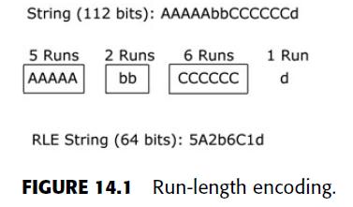
The Mathematical side of games
Data Compression:
RUN-LENGTH ENCODING
Generally every piece of data is in the form of a (n, val) pair, where n is a number and val is the value that was encoded.
A visual representation of run-length encoding is shown in Figure 14.1.

Slide 149
The Mathematical side of games
Data Compression:
RUN-LENGTH ENCODING
A situation to consider when using run-length encoding is the number of runs for each piece of information.
If many runs are not greater than 1, then the data used to represent the encoded value will be twice as long as the original value itself.
For example, take the following piece of information:
ABCCDEEEFFGH
The encoded form of the string would look like the following:
1A1B2C1D3E2F1G1H

Slide 150
The Mathematical side of games
Data Compression:
RUN-LENGTH ENCODING
In games a common use for run-length encoding is for texture images.
Although run-length encoding-compressed data cannot be used directly on the graphics hardware like some texture compression algorithms that will be discussed later, it can be used to save disk space with images that can make good use of the technique.
In the case of compressing an image with run-length encoding, the value of each encoded piece of data is an image pixel.

Slide 151
The Mathematical side of games
Data Compression:
RUN-LENGTH ENCODING
Because of the nature of images, this brings up another point.
What if the following RGB color values were found: Five pixels of (255,128, 74), five pixels of (255, 125, 70), and so on.
If there is a run of five pixels that use (255, 128, 74) and a run of five pixels that use (255, 125, 70), then, since the two colors are very close without any major noticeable difference, they can both be represented as (255, 128, 74), which would give us 10 (255, 128, 74).

Slide 152
The Mathematical side of games
Data Compression:
RUN-LENGTH ENCODING:
Adjusting close-by pixels to match one another to improve the run-length encoding efficiency in this manner will turn the algorithm from lossless to lossy because the original data’s quality or accuracy has been altered.
If this was done and the image was decompressed and saved, the areas where there was once a slight change in color would now be one solid color.

Slide 153
The Mathematical side of games
Data Compression:
RUN-LENGTH ENCODING:
Recompressing the compressed data might even cause pixels that were originally not close to one another but were close after the first compression to be further optimized into a longer run of the same value.
This is one reason it is not always desirable to recompress compressed information when using a lossy algorithm and to instead just compress the original data again.

Slide 154
The Mathematical side of games
Data Compression:
HUFFMAN CODING:
The Huffman coding algorithm is a lossless data compression algorithm created by David A.
Huffman in the 1950s. The Huffman coding algorithm uses various data structures such as the binary tree and priority queue to compress data efficiently.
The Huffman code uses binary digits to traverse a binary tree. For example, if 0 means to go left and 1 means to go right, a binary tree of letters in the alphabet could look like Figure 14.3

Slide 155
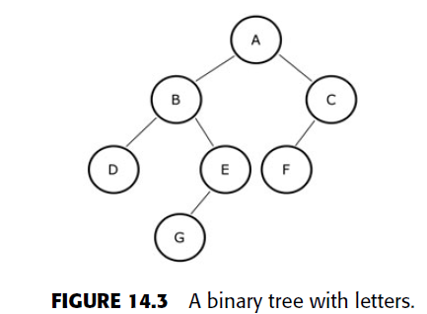
The Mathematical side of games
Data Compression:
HUFFMAN CODING:

Slide 156
The Mathematical side of games
Data Compression:
HUFFMAN CODING:
In Figure 14.3 only 3 bits are used to represent the letter “A” instead of the normal 8 bits that a byte normally uses.
Doing this with all bytes in a source of data can allow the data to be compressed very tightly while remaining lossless in its compression scheme.
The Huffman algorithm is generally quite simple to implement for those with knowledge of priority queues and binary trees.

Slide 157
The Mathematical side of games
Data Compression:
HUFFMAN CODING:
In this section, to make the visualization easier, we will use the letters of the alphabet as an example of data that are being compressed.
For example, take the following string:
Susie sells sea shells at the sea shore
The first step of the algorithm is to figure the frequency of every letter in the string.
For the letter “S” this frequency is the number of times it shows up in the data, which is nine times.
Every letter in the message has a frequency that is determined by the algorithm.

Slide 158
The Mathematical side of games
Data Compression:
HUFFMAN CODING:
The next step is to create a node for each letter in the message and to store each of these nodes in a priority queue.
A node in a Huffman tree has pointers to the left and right child nodes and a frequency number.
The priority queue will sort the nodes by frequency from least to greatest.

Slide 159
The Mathematical side of games
Data Compression:
HUFFMAN CODING:
The third step is to use a loop to remove the top two nodes from the priority queue.
Since the priority queue stores its elements from least to greatest, these two nodes are the nodes with the smallest frequencies.
The two removed nodes are made child nodes of a new node, and the new node has a frequency that equals the first node’s plus the second node’s frequency.
This new node is then inserted into the priority queue, which is shown in Figure 14.4.

Slide 160
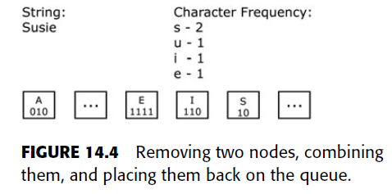
The Mathematical side of games
Data Compression:
HUFFMAN CODING:

Slide 161
The Mathematical side of games
Data Compression:
HUFFMAN CODING:
Performing this until there is only one large node left in the priority queue will create the Huffman tree.
The Huffman tree is a binary tree of all the pieces of information that make up the data.
If the value 0 means to go left and 1 means to go right, then every letter in the example string can be mapped to a few binary digits.
The higher the frequency (i.e., the most times a letter is used in the data), the lower the number of bits that are used to store it.
An example of this Huffman tree is shown in Figure 14.5.

Slide 162
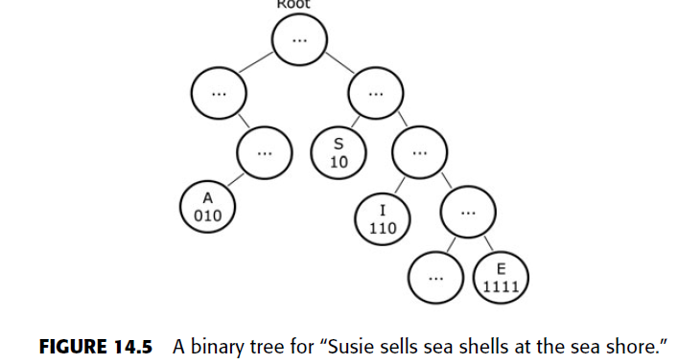
The Mathematical side of games
Data Compression:
HUFFMAN CODING:

Slide 163
The Mathematical side of games
Data Compression:
HUFFMAN CODING:
The next step to the Huffman coding algorithm is to create a Huffman table.
This table is an array that holds the bits necessary to traverse through the binary tree to find a letter.
An example of this is shown in Figure 14.6.

Slide 164
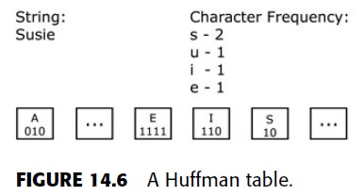
The Mathematical side of games
Data Compression:
HUFFMAN CODING:

Slide 165
The Mathematical side of games
Data Compression:
HUFFMAN CODING:
Encoding data using the Huffman coding algorithm would require a loop to go through the original data and replace each (using strings as an example) letter with the binary digits necessary to look it up in the binary tree.
This encoded data along with the Huffman table can be saved and decoded later.

Slide 166
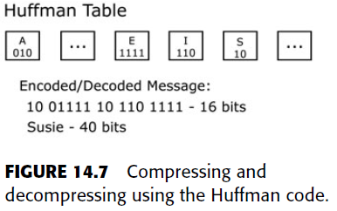
The Mathematical side of games
Data Compression:
HUFFMAN CODING:
To decode the information the Huffman tree can be generated out of the Huffman table, and the binary digits of the encoded message can be processed and decompressed.
An example of this is shown in Figure 14.7.

Slide 167
The Mathematical side of games
Data Compression:
HUFFMAN CODING: The Huffman coding algorithm for encoding can be summarized as the following:
1. Get the frequency for every piece of data.
2. Create a node for each of these pieces and place them into a priority queue based on their frequencies from least to greatest.
3. Remove two nodes at a time from the priority queue. Make those nodes child nodes of a new node, where the new node’s frequency is equal to the frequencies of its children added together, and place the new node into the priority queue. Continue until there is only one node left, which is the Huffman tree.
4. Go through all the leaf nodes of the Huffman tree to determine what path is necessary to get to each piece of data. Store this path data of 0s and 1s in an array known as a Huffman table.
5. Encode the data using the Huffman table.

Slide 168
The Mathematical side of games
Data Compression:
HUFFMAN CODING:
The Huffman coding algorithm for decoding can be summarized as the following:
1. When decoding the data, use the Huffman table to generate the Huffman tree.
2. When processing the data to be decoded, use each bit as a direction for traversing the Huffman tree.
3. When a leaf node is reached, that piece of data at the node is the decoded value.
4. Continue until all compressed data have been processed.

Slide 169
The Mathematical side of games
Data Compression:
HUFFMAN CODING:
To decode data the algorithm you will need is either the Huffman table, so that the Huffman tree can be generated, or the Huffman tree itself.
The Huffman table can easily be saved to a file with the compressed data or transferred across a connection much more easily and efficiently than a tree that uses pointers to nodes.
The tree itself is used for decoding a message and for creating the Huffman table. The Huffman table, along with being used for generating the tree if needed, serves as a look-up table for encoding the original data.

Slide 170
The Mathematical side of games
INTRODUCTION TO TEXTURE COMPRESSION :
The amount of data used to represent virtual worlds in a video game is growing with every generation.
A lot of this increase in data comes from increased numbers of textures and an increase in their resolutions.
Texture data takes up a lot of space. Of course, there are other resources that take up a lot of space such as video, audio, geometry, and so on, but textures have become a major focus for compression.

Slide 171
The Mathematical side of games
INTRODUCTION TO TEXTURE COMPRESSION :
Compressing textures have quite a few benefits in game development.
The first benefit is that the textures take up less space on the storage device.
With the number of textures a game uses increasing, the extra space can come in handy. Using a compression algorithm that gives a 4:1 compression ratio on a 32-bit 1024 × 1024 texture would give you the following comparison:
Original data size: 4 bytes per pixel × (1024 × 1024) = 4,194,304 bytes or 4.2 MB
Compressed size: Original size/4 = 1 MB (give or take a few kilobytes)

Slide 172
The Mathematical side of games
INTRODUCTION TO TEXTURE COMPRESSION :
If the compression ratio was 6:1, like one of the techniques that will be discussed shortly, the compressed size for a 32-bit 1024 × 1024 texture would be 700 kilobytes. Such a savings is huge for a large texture.
The advantage about texture compression is that the compressed data take up less storage space on a disk, but it also takes up less bandwidth and memory inside the game. The faster a texture can be moved through the pipeline, the better the performance. When it comes to rendering, one of the most expensive operations is switching textures. This cost can be minimized by using state-management techniques.

Slide 173
The Mathematical side of games
INTRODUCTION TO TEXTURE COMPRESSION :
Because graphics hardware is able to load and work with compressed data, there are many opportunities to use high-definition content in video games.
Using the best compression method for the type of texture you are dealing with can go a long way toward create stunning, high definition and high-resolution virtual scenes.

Slide 174
The Mathematical side of games
INTRODUCTION TO TEXTURE COMPRESSION :
Some popular compression methods used in the game industry for compressing color maps and normal maps.
Each method has its strengths and weaknesses.
The first types of image compression algorithms that will be discussed for textures are S3 texture compression algorithm formats (the OpenGL version of DirectX DXTC), which include DXT1 through DXT5. Before moving on let’s briefly discuss normal maps.

Slide 175
The Mathematical side of games
INTRODUCTION TO TEXTURE COMPRESSION :
Bump mapping(Bump mapping is a texture mapping technique in computer graphics for simulating bumps and wrinkles on the surface of an object) is an extension to per-pixel lighting. In per-pixel lighting the lighting algorithms are performed on each fragment of a rendered object.
Bump mapping is a 3-D graphics simulation technique that uses object lighting calculations to alter texture map surface bumps without additional polygons.
In traditional per-pixel lighting this leads to smooth lighting contributions across an entire surface.
With per-vertex lighting, the lighting quality mostly depended on the number of vertices in the mesh, while in per-pixel lighting it mostly depends on the screen resolution of the rendered scene.

Slide 176
The Mathematical side of games
INTRODUCTION TO TEXTURE COMPRESSION :
Bump mapping extends per-pixel lighting by varying the normals at the fragment level to create patterns that have different lighting contributions.
These patterns can give the illusion of detail on an object. Bump maps are images that store the normal X, Y, Z in the color components R, G, B.
Texture mapping can apply a bump map onto a surface that allows the pixel shader to access that information.
The main difference between bump mapping and per-pixel lighting is the normal it uses for the lighting.

Slide 177
The Mathematical side of games
INTRODUCTION TO TEXTURE COMPRESSION :
For bump mapping this is a normal it fetches from the
bump map, while for per-pixel lighting it is the normal at the surface normal.
Bump maps are height maps that specify a pattern.
Normal mapping is essentially bump mapping, but instead of using a height map with a pattern, which is normally created by an artist, normal maps use height maps that are calculated from a low-polygon mesh and a high-polygon mesh.

Slide 178
The Mathematical side of games
INTRODUCTION TO TEXTURE COMPRESSION :
Calculating the difference between a low- and high-polygon model, the resulting normal map can be used to perform bump mapping on the low-polygon model so that it looks like the high-polygon version.
This technique is used in many of today’s games to give models and environments the appearance of detail and complexity while keeping the polygon count low enough for real-time rendering.

Slide 179
The Mathematical side of games
INTRODUCTION TO TEXTURE COMPRESSION :
DXTC COMPRESSION:
The DXTC image compression methods are texture compression formats that are good for getting a compression ratio of 6:1 on color images using DXT1 and a 4:1 compression ratio using the other DXT formats.
The DXTC compression formats use a lossy type of compression, so the quality of color maps can be less than the original, and they are not the best choice for compressing normal map images.

Slide 180
The Mathematical side of games
INTRODUCTION TO TEXTURE COMPRESSION :
DXTC COMPRESSION:
The reason they are not good to use with normal maps lies with the normal values themselves.
To provide accurate lighting across a surface, the normals will need to be relatively intact.
A screenshot of a normal map using lossy compression is shown in Figure 14.8.
By using a lossy compression like the DXTC formats on
normal maps you will be giving up lighting accuracy and quality, and this can hurt the look of a scene.

Slide 181
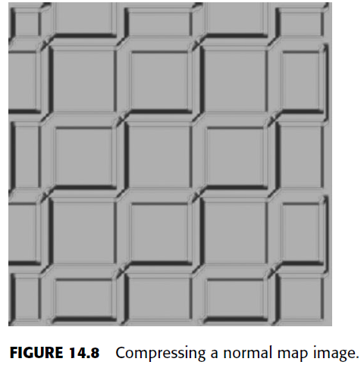
The Mathematical side of games
INTRODUCTION TO TEXTURE COMPRESSION :
DXTC COMPRESSION:

Slide 182
The Mathematical side of games
INTRODUCTION TO TEXTURE COMPRESSION :
DXTC COMPRESSION:
The DXTC formats are great for decal images, but the format version used depends on the quality given from the compression.
The DXT1 gives the lowest overall quality but also gives the most compression.
Each version above the DXT1 has better quality than the one that came before it but at the cost of compression size.
The DXT5 often gives the best quality but does not get the most compression.

Slide 183
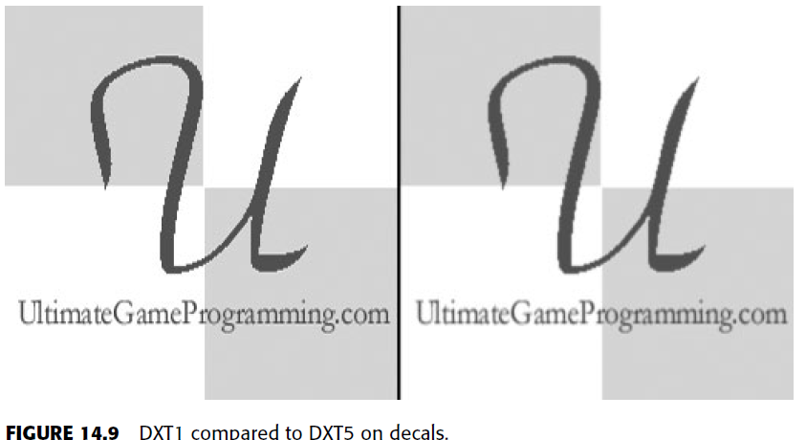
The Mathematical side of games
INTRODUCTION TO TEXTURE COMPRESSION :
DXTC COMPRESSION:A comparison of a texture image compressed with DXT1 and DXT5 is shown in Figure 14.9. A comparison of these formats on a normal map is shown in Figure 14.10.

Slide 184
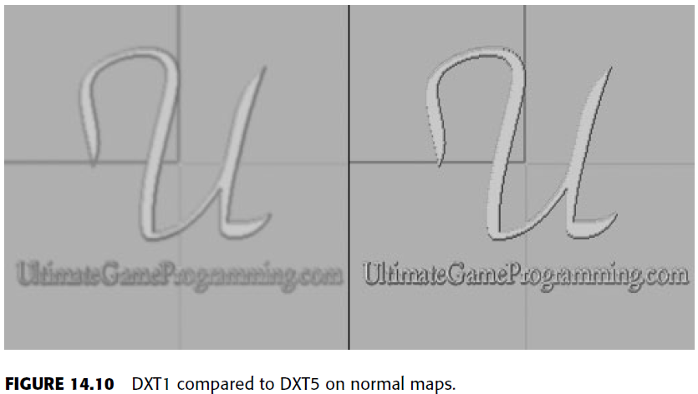
The Mathematical side of games
INTRODUCTION TO TEXTURE COMPRESSION :
DXTC COMPRESSION:

Slide 185
The Mathematical side of games
INTRODUCTION TO TEXTURE COMPRESSION :
DXTC COMPRESSION:
Normal maps are not good for DXTC compression because the DXTC formats assume that the image data are smooth across its pixels.
In a normal map there are often sharp changes that are used to give detail and variations for the lighting algorithms.
Because normal maps are often not smooth, the normals can be compressed and altered to a point where the detail is lost and the lighting does not look as intended.

Slide 186
The Mathematical side of games
INTRODUCTION TO TEXTURE COMPRESSION :
DXTC COMPRESSION:
Using only 16 bits for each color component is not enough precision for normals in a normal map. Also, specular lighting and normal maps compressed with a DXTC format can further amplify the rendering artifacts that exist on the rendered surface.
There are a few tricks to getting normal maps to compress with DXTC formats while retaining an acceptable level of quality.
These options are not as useful as the 3Dc compression format, which will be examined later, but they can work if DXTC must be used.

Slide 187
The Mathematical side of games
INTRODUCTION TO TEXTURE COMPRESSION :
DXTC COMPRESSION:
The tricks that can be used to increase the quality of a normal map using a DXTC format include: Renormalizing normals as they are fetched from a texture.
Placing the x-axis of a normal in the alpha channel of a DXT5 compression since the alpha channel is compressed separately.
Taking the previous trick, fetching the y-axis from the normal, and generating the z-axis instead of using the one from the normal map.

Slide 188
The Mathematical side of games
INTRODUCTION TO TEXTURE COMPRESSION :
DXTC COMPRESSION:
Generating the z-axis is a clever and easy means of working with compressed normals. By generating the z-axis, the normal can always be unit-length without
needing to renormalize the vector. A unit normal is a vector whose length (magnitude) equals 1, like so:
1 = square_root(X * X + Y * Y + Z * Z).
If we know the x-axis and the y-axis, the z-axis can be calculated using the simple
Formula Z = square_root(1 – (X * X – Y * Y)).

Slide 189
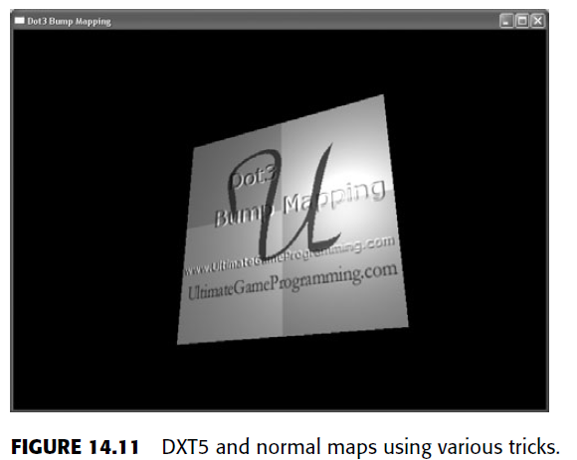
The Mathematical side of games
INTRODUCTION TO TEXTURE COMPRESSION :
DXTC COMPRESSION:
Generating the z-axis and using DXT5 with the x-axis stored in the alpha channel can give you the best results when compressing normal maps using the DXTC formats. A screenshot is shown in Figure 14.11.

Slide 190
The Mathematical side of games
INTRODUCTION TO TEXTURE COMPRESSION :
DXTC COMPRESSION:
The DXT1 format gives the most compression at a ratio of 8:1 but does not use an alpha channel. The DXT1 format uses 16-bit color values at 5-6-5 (red 5, green 5, blue 5).
The algorithm for the DXT1 format splits the image up into 4 x 4 pixel blocks.
Each block stores only two unique colors and uses a 16-bit palette.

Slide 191
The Mathematical side of games
INTRODUCTION TO TEXTURE COMPRESSION :
DXTC COMPRESSION:
The pixels in each block reference an entry in the block’s palette, allowing the colors to be represented using less data.
Because the format uses 4 × 4 blocks, gradient information often becomes clearly blocky, with many unwanted visual artifacts.
These artifacts can be seen on the three-dimensional object that is textured with a DXT1 compressed image in Figure 14.12.

Slide 192
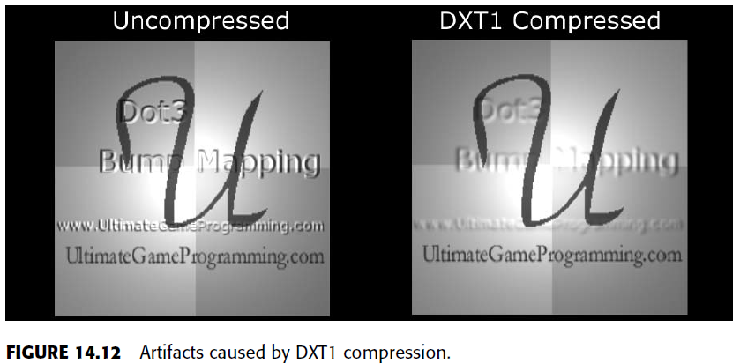
The Mathematical side of games
INTRODUCTION TO TEXTURE COMPRESSION :
DXTC COMPRESSION:

Slide 193
The Mathematical side of games
INTRODUCTION TO TEXTURE COMPRESSION :
DXTC COMPRESSION:
The DXT2 format is similar to the DXT1 format, with the exception that the DXT2 format uses a 4-bit alpha that is multiplied before the compression so that more transparent pixels appear darker than opaque ones.
The DXT3 format is similar to the DXT2 format, with the exception that the DXT2 format premultiplies the data by the alpha channel and the DXT3 does not.

Slide 194
The Mathematical side of games
INTRODUCTION TO TEXTURE COMPRESSION :
DXTC COMPRESSION:
The DXT4 and DXT5 compression formats are similar to the DXT3 format, but the DXT4 alpha channel is premultiplied as it is with the DXT2 format, and the DXT5 format interpolates the alpha channel when compressing the original image data.

Slide 195
The Mathematical side of games
INTRODUCTION TO TEXTURE COMPRESSION :
3Dc COMPRESSION :
The 3Dc texture compression, created by ATI, is a lossy compression format used for normal map images.
The 3Dc texture compression offers a compression ratio of 4:1. With the 3Dc format a texture is broken up into 4 x 4 blocks of pixels of 16 values each.
Each of these values has two components that are compressed separately.
When compressing normal maps, this is good because the z-axis can be calculated and the x and y axes can be compressed and stored. A comparison of the 3Dc and DXT5 formats and an uncompressed normal map is shown in Figure 14.14.

Slide 196
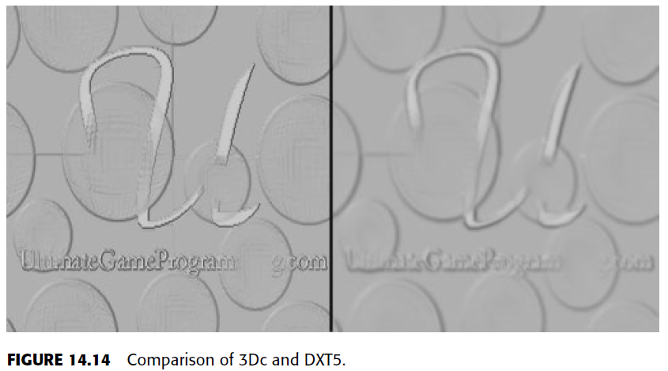
The Mathematical side of games
INTRODUCTION TO TEXTURE COMPRESSION :
3Dc COMPRESSION :
A comparison of the 3Dc and DXT5 formats and an uncompressed normal map is shown in Figure 14.14.

Slide 197
The Mathematical side of games
INTRODUCTION TO TEXTURE COMPRESSION :
3Dc COMPRESSION :
3Dc is the compression format of choice for normal map images, while DXT5 can be a good general choice for color maps (depending on the texture and the visual requirements).
A free tool to create 3Dc texture images can be found on ATI’s Web site and is called the ATI Compressonator.

Slide 198
The Mathematical side of games
INTRODUCTION TO TEXTURE COMPRESSION :
A8L8 FORMAT :
The format that will be discussed next is not a compression format as much as it is a format used for normal maps.
A normal map can calculate the z-axis (or any axis for that matter, as long as two are already known).
With the A8L8 format the texture data are represented just as they are for a normal texture, but minus the blue component (z-axis).
The Direct3D and OpenGL graphics API allows for two component texture images to be created and used.

Slide 199
The Mathematical side of games
INTRODUCTION TO TEXTURE COMPRESSION :
A8L8 FORMAT :
Because of this, a file that uses only two components in this manner can be used directly in the API, and the missing component can be calculated in a pixel shader.
Note that because the data in an A8L8 texture are not lossy compressed, the quality of the data remains unaffected.

Slide 200
The Mathematical side of games
INTRODUCTION TO TEXTURE COMPRESSION :
A8L8 FORMAT :
Implementation will use OpenGL as the rendering API and will also use the DDS (Direct-Draw Surface) image format.
The DDS file format is a DirectX file format used for storing image information.
Although the file format was first used in DirectX, it can be easily loaded and used outside of the Windows graphics API. When loading a DXTC-compressed image in OpenGL, the compressed contents can be loaded directly into the rending API so that the compressed information is used internally.

Slide 201
The Mathematical side of games
INTRODUCTION TO DATA ENCRYPTION :
Another topic that is important to software development is encryption. Information has become an important part of the age we live in.
Information on everything and anything can be shared by billions through media like the Internet, and the need to protect this information is very important.
Not only is this needed to protect sensitive data such as credit card numbers, but in video games data sometimes needs protecting from malicious users who intend to cheat or disrupt a network.

Slide 202
The Mathematical side of games
INTRODUCTION TO DATA ENCRYPTION :
Another topic that is important to software development is encryption. Information has become an important part of the age we live in.
Information on everything and anything can be shared by billions through media like the Internet, and the need to protect this information is very important.
Not only is this needed to protect sensitive data such as credit card numbers, but in video games data sometimes needs protecting from malicious users who intend to cheat or disrupt a network.

Slide 203
The Mathematical side of games
INTRODUCTION TO DATA ENCRYPTION :
Cryptography is the process of scrambling data into a form that is unreadable without some special way to translate the information.
In cryptography a cipher is used to perform encryption and decryption.
A cipher is an algorithm that is performed on the data. These algorithms often depend on a key that the algorithm uses to transform the data.
This key is like a password, and without it the encrypted message can not be decrypted, or at least it would be very difficult.

Slide 204
The Mathematical side of games
INTRODUCTION TO DATA ENCRYPTION :
The different kinds of ciphers include stream ciphers and block ciphers.
The different kinds of keys include asymmetric and symmetric keys.
A symmetric key is a key that is used for both the encryption and the decryption, while an asymmetric key is used in conjunction with other keys to encrypt or decrypt.
The data that are encrypted are known as ciphertext.

Slide 205
Introduction to Physics Modeling
INTRODUCTION :
Physics simulation is a field within computer science that aims to reproduce physical phenomena using a computer.
In general, these simulations apply numerical methods to existing theories to obtain results that are as close as possible to what we observe in the real world.
This allows us, as advanced game developers, to predict and carefully analyze how something would behave before actually building it, which is almost always simpler and cheaper to do.

Slide 206
Introduction to Physics Modeling
INTRODUCTION :
The range of applications of physics simulations is enormous.
The earliest computers were already being used to perform physics simulations – for example, to predict the ballistic motion of projectiles in the military.
It is also an essential tool in civil and automotive engineering, illuminating how certain structures would behave in events like an earthquake or a car crash.
We can simulate things like astrophysics, relativity, and lots of other insane stuff we are able to observe in among the wonders of nature.

Slide 207
Introduction to Physics Modeling
INTRODUCTION :
Simulating physics in video games is very common, since most games are inspired by things we have in the real world.
Many games rely entirely on the physics simulation to be fun.
That means these games require a stable simulation that will not break or slow down, and this is usually not trivial to achieve.

Slide 208
Introduction to Physics Modeling
INTRODUCTION :
In any game, only certain physical effects are of interest. Rigid body dynamics – the movement and interaction of solid, inflexible objects – is by far the most popular kind of effect simulated in games.
That’s because most of the objects we interact with in real life are fairly rigid, and simulating rigid bodies is relatively simple (although as we will see, that doesn’t mean it’s a cakewalk).
A few other games require the simulation of more complicated entities though, such as deformable bodies, fluids, magnetic objects, etc.

Slide 209
Introduction to Physics Modeling
Rigid Body Dynamics:
In video game physics, we want to animate objects on screen and give them realistic physical behavior.
This is achieved with physics-based procedural animation, which is animation produced by numerical computations applied to the theoretical laws of physics.

Slide 210
Introduction to Physics Modeling
Rigid Body Dynamics:
Animations are produced by displaying a sequence of images in succession, with objects moving slightly from one image to the next.
When the images are displayed in quick succession, the effect is an apparent smooth and continuous movement of the objects.
Thus, to animate the objects in a physics simulation, we need to update the physical state of the objects (e.g. position and orientation), according to the laws of physics multiple times per second, and redraw the screen after each update.

Slide 211
Introduction to Physics Modeling
Rigid Body Dynamics:
The physics engine is the software component that performs the physics simulation.
It receives a specification of the bodies that are going to be simulated, plus some configuration parameters, and then the simulation can be stepped.
Each step moves the simulation forward by a few fractions of a second, and the results can be displayed on screen afterwards.
Note that physics engines only perform the numerical simulation. What is done with the results may depend on the requirements of the game. It is not always the case that the results of every step wants to be drawn to the screen..

